Slide 1
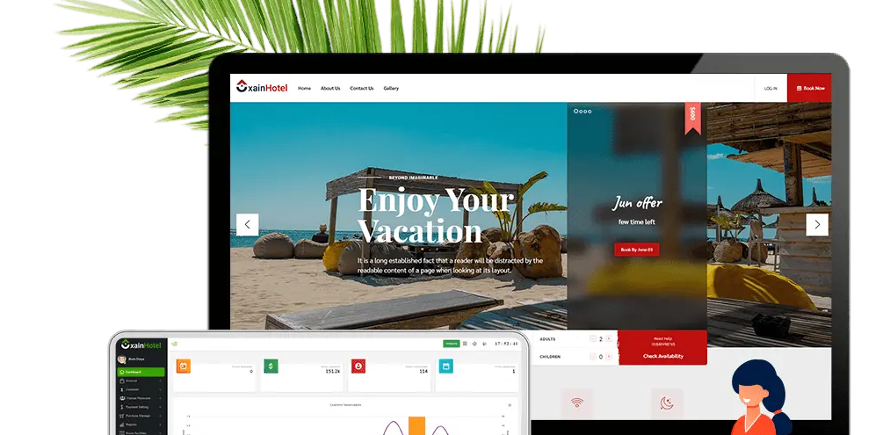
Hotel Management System

Slide 2
CONSULTANT.
Md. Moshaidul Islam
wdpf.idb-bisew it scholarship
Email: moshaidul@gmail.com
FARHANA AKTER LUCKY
Instructor:
wdpf idb-bisew it scholarship
Email: farhanawdpf@gmail.com
DEVELOPED BY.
Name: Md Tarikul Islam
Trainee ID:1273629
Batch: WDPF/NCLC-M/54/01
Email:tarikulat124@gmail.com

Slide 3
Md. Moshaidul Islam
Consultant
WDPF-IDB-BISEW
Sher-e-Bangla Nagar, Dhaka
Subject: Hotel Management System
Project Proposal
Dear Sir,
Thank you for offering me a great opportunity to make a real life project based on our core course that is Web Development with PHP and Framework (WDPF). In this respect, | would like to inform you that | have decided to make a project on hotel management system, which is most importance for every business communities. | have studied about the various aspects of this system and make a proposal accordingly which is enclosed herewith for your kind perusal. So, I think you will finally Approved the project and help to utilize my creativity.
Sincerely
Name :Md Tarikul Islam
ID:1273629

Slide 4
Hotel Management System
User Management
a. Login.
b. User profile.
c. Update information.
d. Role based rights.
Package Modules
User can view different room packages available for customers. User can select any packages from this module he can also check the details of various in hotel management system. A user can select any packages from this module.

Slide 5
Description of procedures and function
This project contains 3 modules namely:-
1. User Registration,
2. Booking Rooms,
3. Submission module,
User Creation:-
In this module we are Registration the username, password, phone and card id’ are user creations.
Booking Room:-
In this module we are Registered the Customer Name, hotel number, room price as well as
paying the money.
Submission Module;-
In this module the admin is confirmed the order and before registering the
Customer name, order no and phone

Slide 6
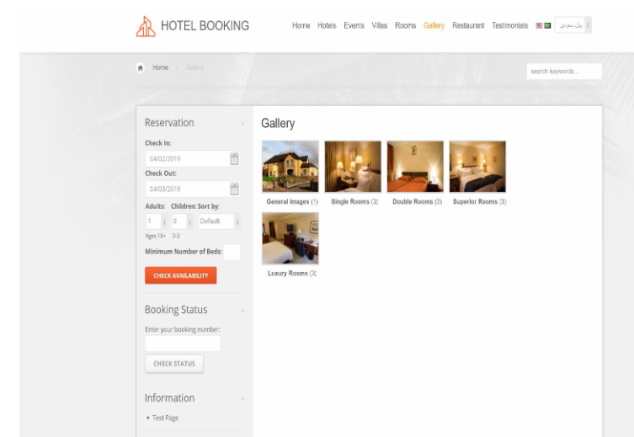
Hotel Reservation

Slide 7
Administrator/Admin :
This module provides administrator related functionality like from this module use can add route information, room information, packages, hotel services details, etc. From this module Admin can view daily, weekly and monthly report. This module is develop for admin of the website and admin can add, delete, edit and view the data related to places , hotel, rooms routes, bookings from this module.
a. Manage user information.
b. Update information.
c. Manage Services.
d. Manage Packages.
e. Manage hotel, Bookings.

Slide 8
Key functions of the reservation module include:
Room bookings. The system checks room availability and status, shows free rooms across different channels and the website booking engine. This function monitors double bookings and allows group reservations. Then it schedules bookings and displays information about current and upcoming bookings on a dashboard.
E-payments processing. Software collects online transactions and classifies them according to their types and categories.
Management of room inventory and allocation. Reservation tools prevent overbookings and double bookings. In some software, this function is part of a channel management module.
Reservation emails. The system sends confirmations to guests after they complete their booking. In some PMSs, this function is a part of the front-desk operations module.
Activities booking. Some software allows guests to book not only accommodation but also activities with this system.

Slide 9
Hotel Module
Details of the hotels in which the accommodation of the customer will be done during the tours. Details like availability of meals, station-pickup and drop facility and contact no. of the hotels are also provided to the customers on special request.
a. Registration (as user)
b. Registration (as Hotel)
c. Search
Payment Module
a. pay payment through Bank Account
b. pay payment through Mobile banking

Slide 10
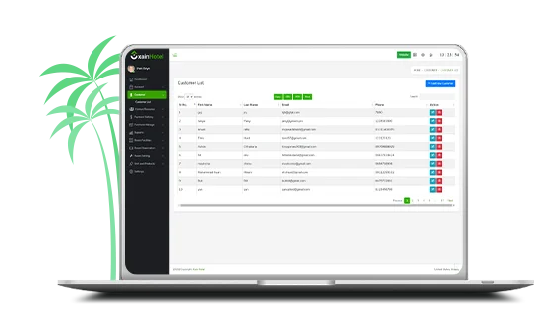
Customer Management
This module can allow you to add new customers and handle the existing customers.
Add Customer
Manage Customer

Slide 11
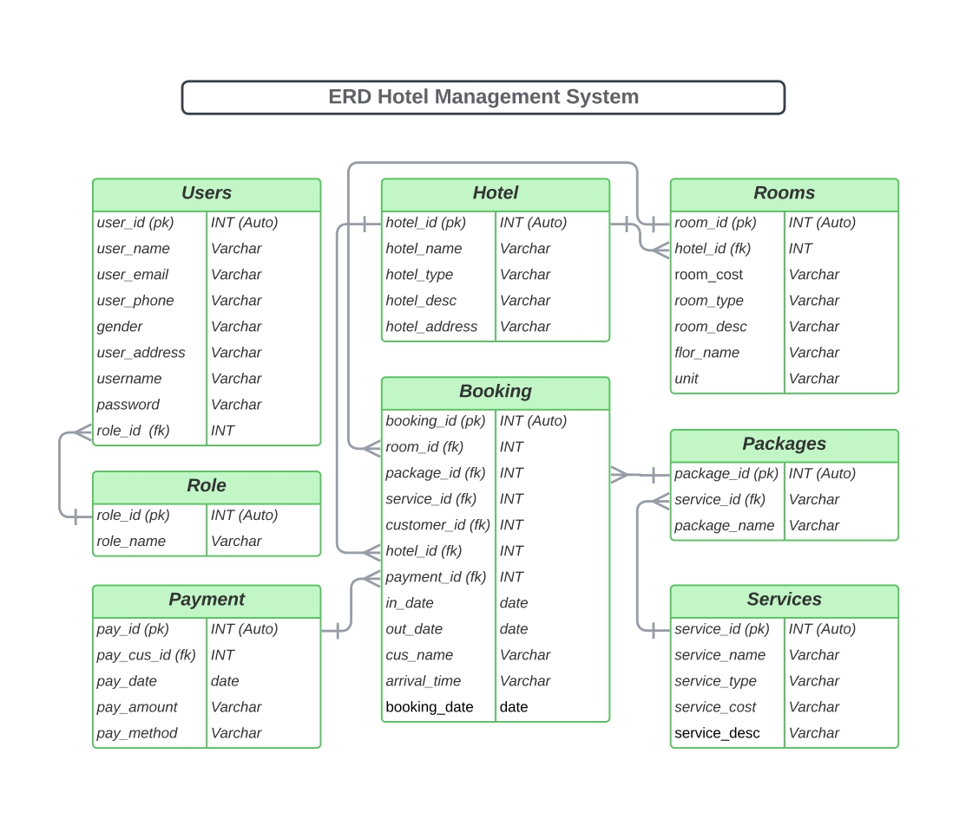

Slide 12
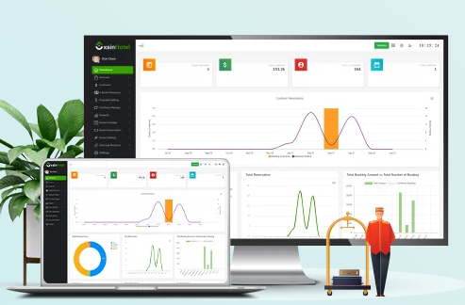
Interactive Dashboard
Total Booking history
Total Reservation
Today Booking List
Next-Day Booking List
Customer List and more!

Slide 13
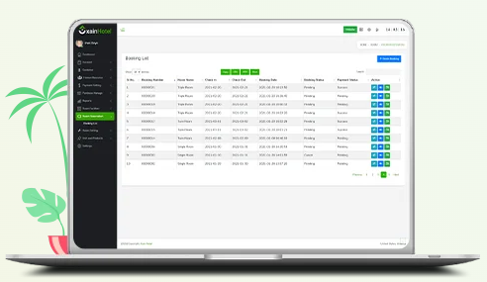
Room Reservation
Hotel Management System provides a complete room reservation system that can allow you to handle all booking-related activities. For example, you can add check-in and check-out times, and this module can automatically generate booking numbers according to the booking information.
Room Booking
Check In
Check Out

Slide 14
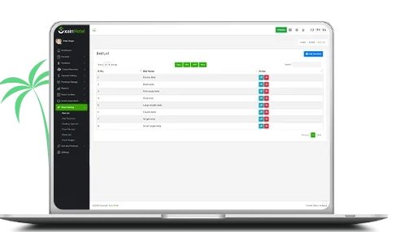
Room Settings
The most significant advantage of this module is that it can allow you to manage the floor plan and upload all the images of your rooms.
Bed List
Start Class List
Manage Booking Types
Manage Floor Plan
Room List
Room Image

Slide 15
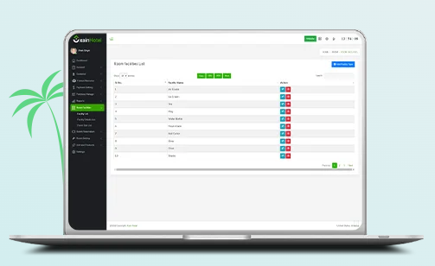
Room Facilities
By using this module, you can add any kind of facility, whatever you want; you just need to put the facility name. Also, you can manage these facilities and create a list of all room sizes through this module.
Manage Facility
Facility Details List
Room Size List

Slide 16
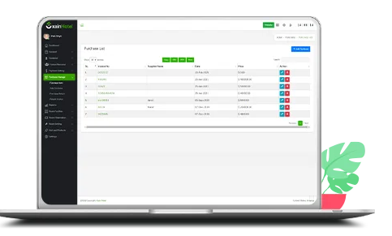
Purchase Management
Here you also can get a Purchase Return sub-module that will allow you to return any defect items which you have purchased.
Add Purchase
Manage Purchase
Purchase Return
Return Invoice

Slide 17
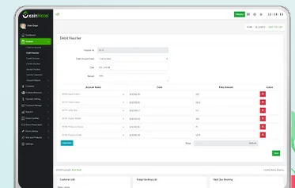
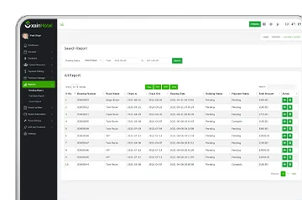
Account Management
Chart of Accounts (COA)
Debit Voucher
Credit Voucher
Contra Voucher
Journal Voucher
Account Reports
Reporting System
Booking Reports
Purchase Reports
Stock Reports

Slide 18
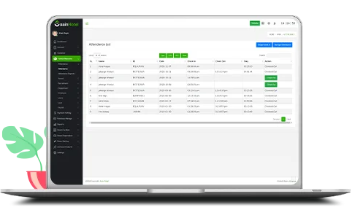
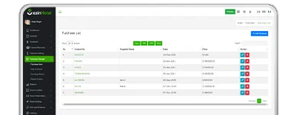
Human Resources Management
Employee Management
Recruitment System
Department
Attendance System
Leave management
Payroll System
Purchase Management
Add Purchase
Manage Purchase
Purchase Return
Return Invoice

Slide 19
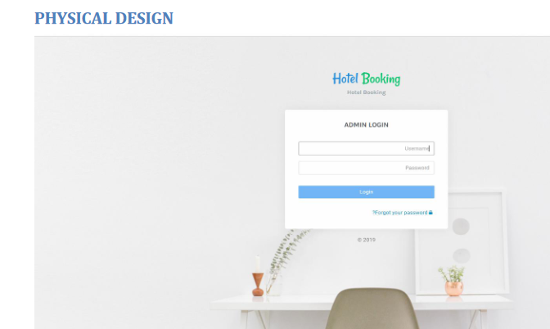

Slide 20
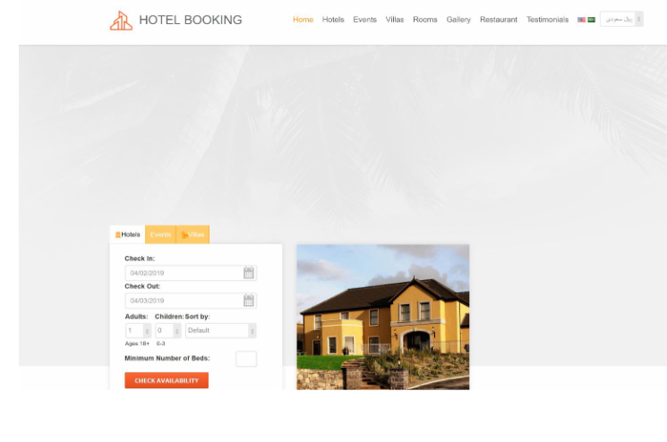

Slide 21
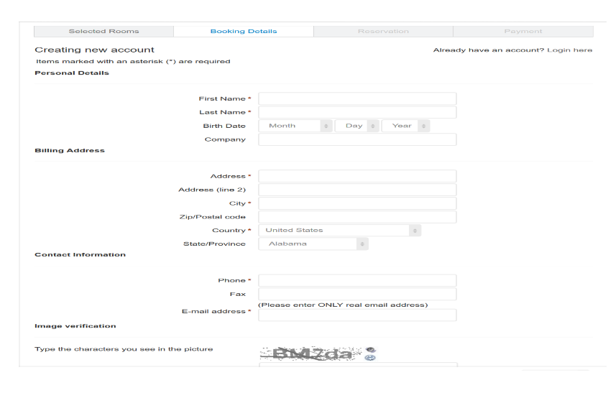
Hotel Booking From

Slide 22
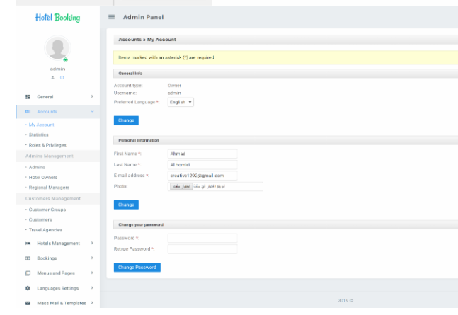

Slide 23
List Of Reports
Customer Report
Packages Type of Report
Booking Category Report
Rooms Package Report
Services Report
Payment Report
Hotel Places
Hotel/Room Report
Profit and Benefit
Order Report
Received Report
User Report
Audit Report
Menu Form

Slide 24
Software Features
Different login system
Controlling Access to perform specific tasks.
Control by Rooms type, category, and rooms package base.
Hotel Booking notification.
Hotel Management system.
Many type Services based.
Hotel Room and Event base system.
Package price and discount system.
Online booking control system.

Slide 25
Software Features
Audit information system.
Flexible purchase and Hotel report.
Flexible dues calculation.
Rooms Package price life cycle report.
Payment analysis report.
Update report of the software.
Online report system.
Repots with graphical view.
communicate by text and calling one to another user.
Auto backup Database.
Safe from Hacker and third parties.

Slide 26
Server Software Configuration
Server Software Configuration:
Operating System: Windows 7 and higher
Language: React
Database: MySQL
Server Hardware Configuration:
Processor: Intel(R) Core(TM) 2Duo CPU @ 2.93 GHz
RAM: 2 GB
Hard Disk Drive: 20 GB
Keyboard: 122 Keys

Slide 27
Technology Stack:
To ensure a robust and scalable web application, we propose
utilizing the following technologies:
- Front-end Development: HTML5, CSS3, Bootstrap and CodeIgniter.
- Back-end Development: php, MySQL.
- Payment Gateway Integration: Virtual Payment, Bank payment
- Map Integration: Google Maps API
- Authentication and Security: JWT, SSL encryption
- Hosting and Deployment: Amazon Web Services (AWS)

Slide 28
Hardware and software requirements:
Hardware Requirements: -
Quad core 2GHz+ CPU.
6GB Ram.
Hard disk 1 TB.
Minimum database space: 10GB.
Software Requirements: -
Operating System : Windows
Web-Technology: pup
Front-End: html5,php
Back-End: myself
Web Server: apache

Slide 29
Conclusion:
This is to conclude that the project that I undertook was worked upon with a sincere effort.
Most of the requirements have been fulfilled up to the mark and the requirements which have
been remaining, can be completed with a short extension.
The project made here is just to ensure that this product could be valid in today real
challenging world. Here all the facilities are made and tested.
Currently the system works for limited number of administrators to work. In near future it will
be extended for many types of insurance policies so that efficiency can be improved

Slide 30
THANKS FOR
STAYING WITHME

